Slide 1

Start
Concept
Process
Implementation
Future
The Team

Slide 2
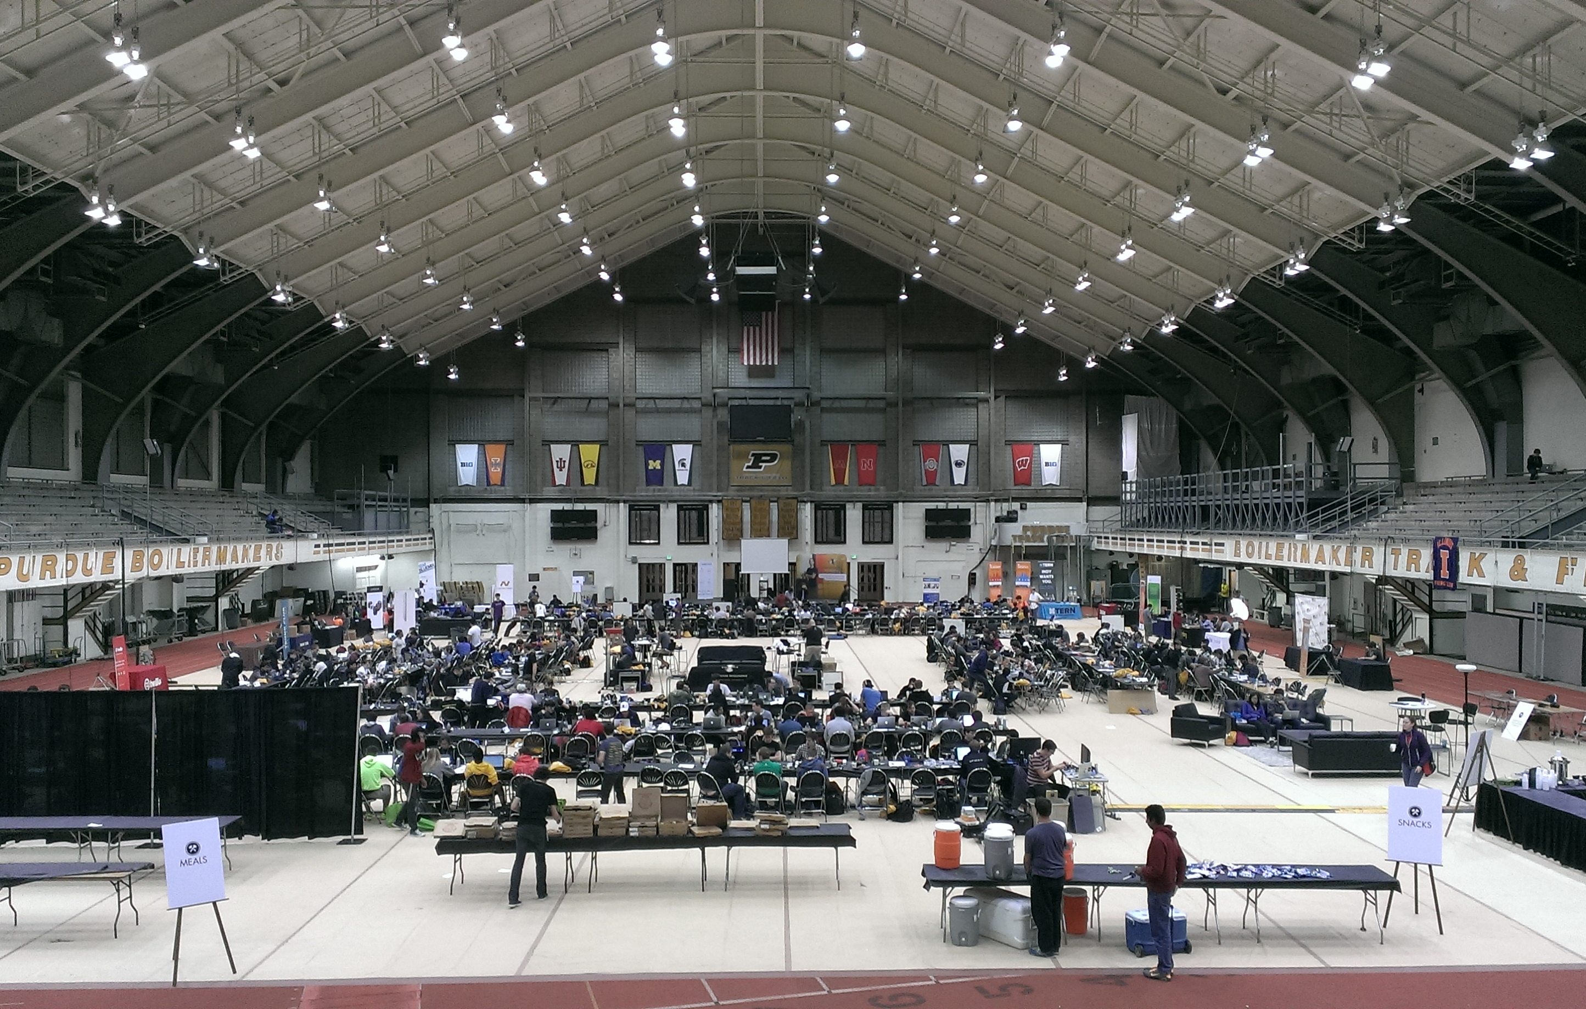
erger

Slide 3
Start
Concept
Process
Implementation
Future
The Team

Slide 4

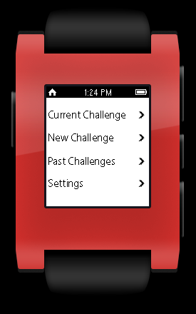
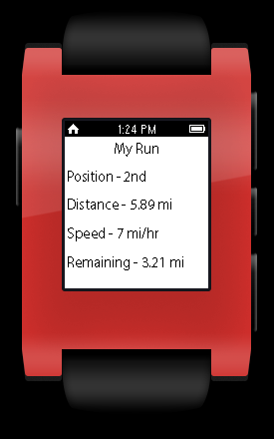
Medium Fidelity Prototyping - Pebble

Slide 5
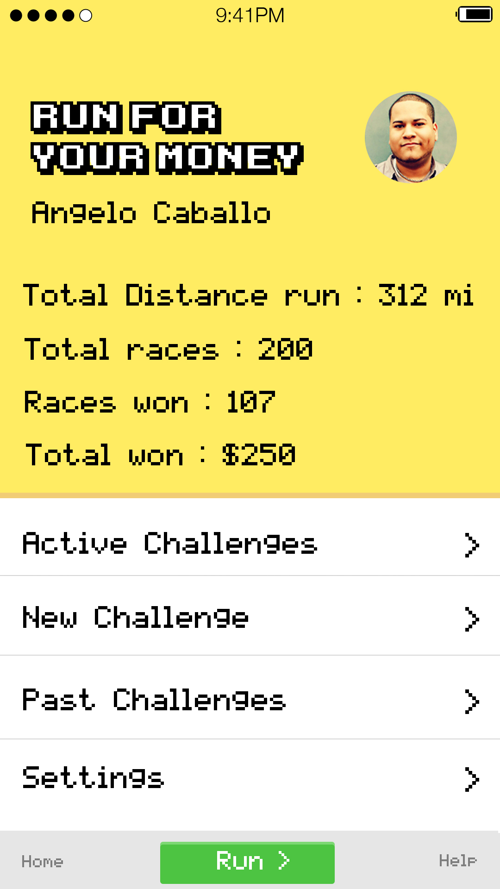
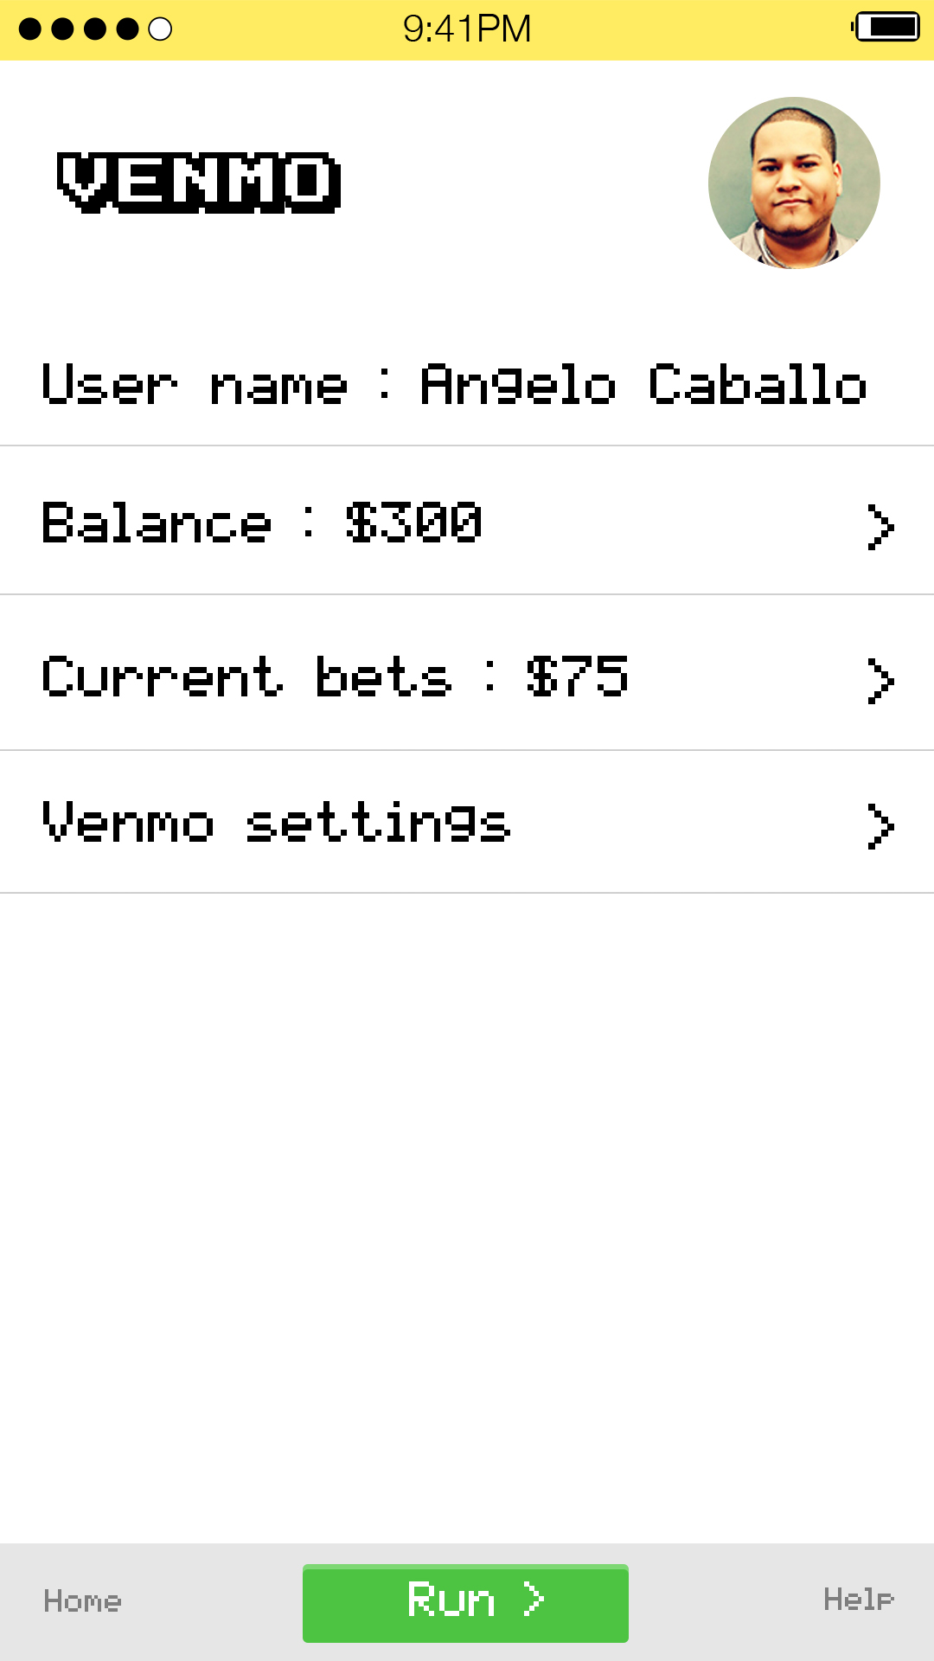
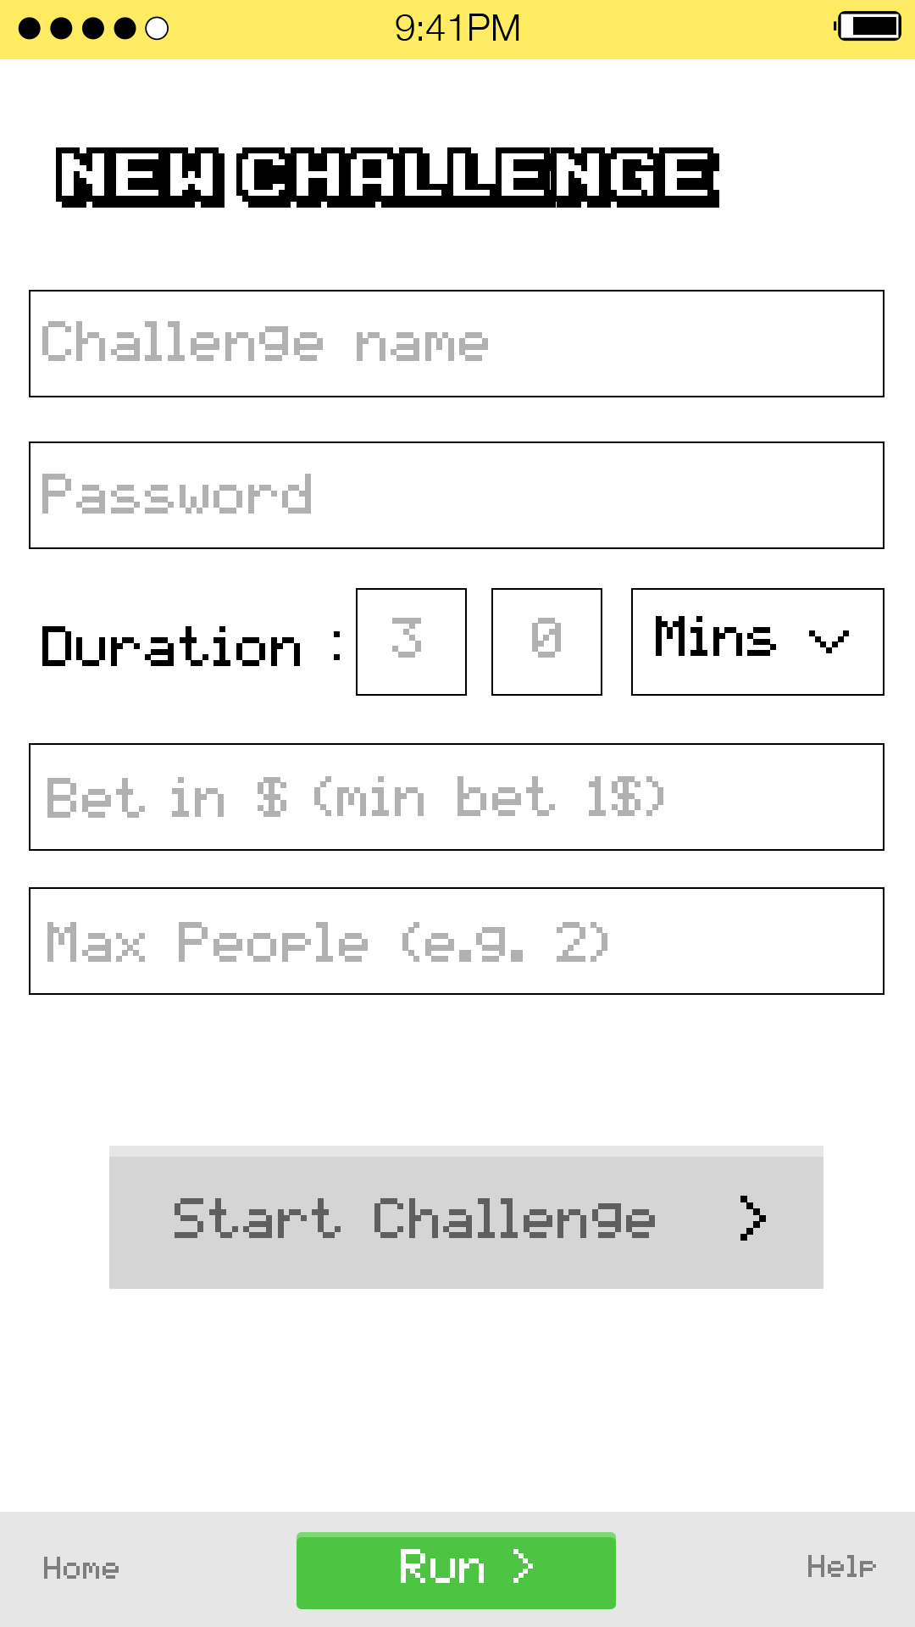
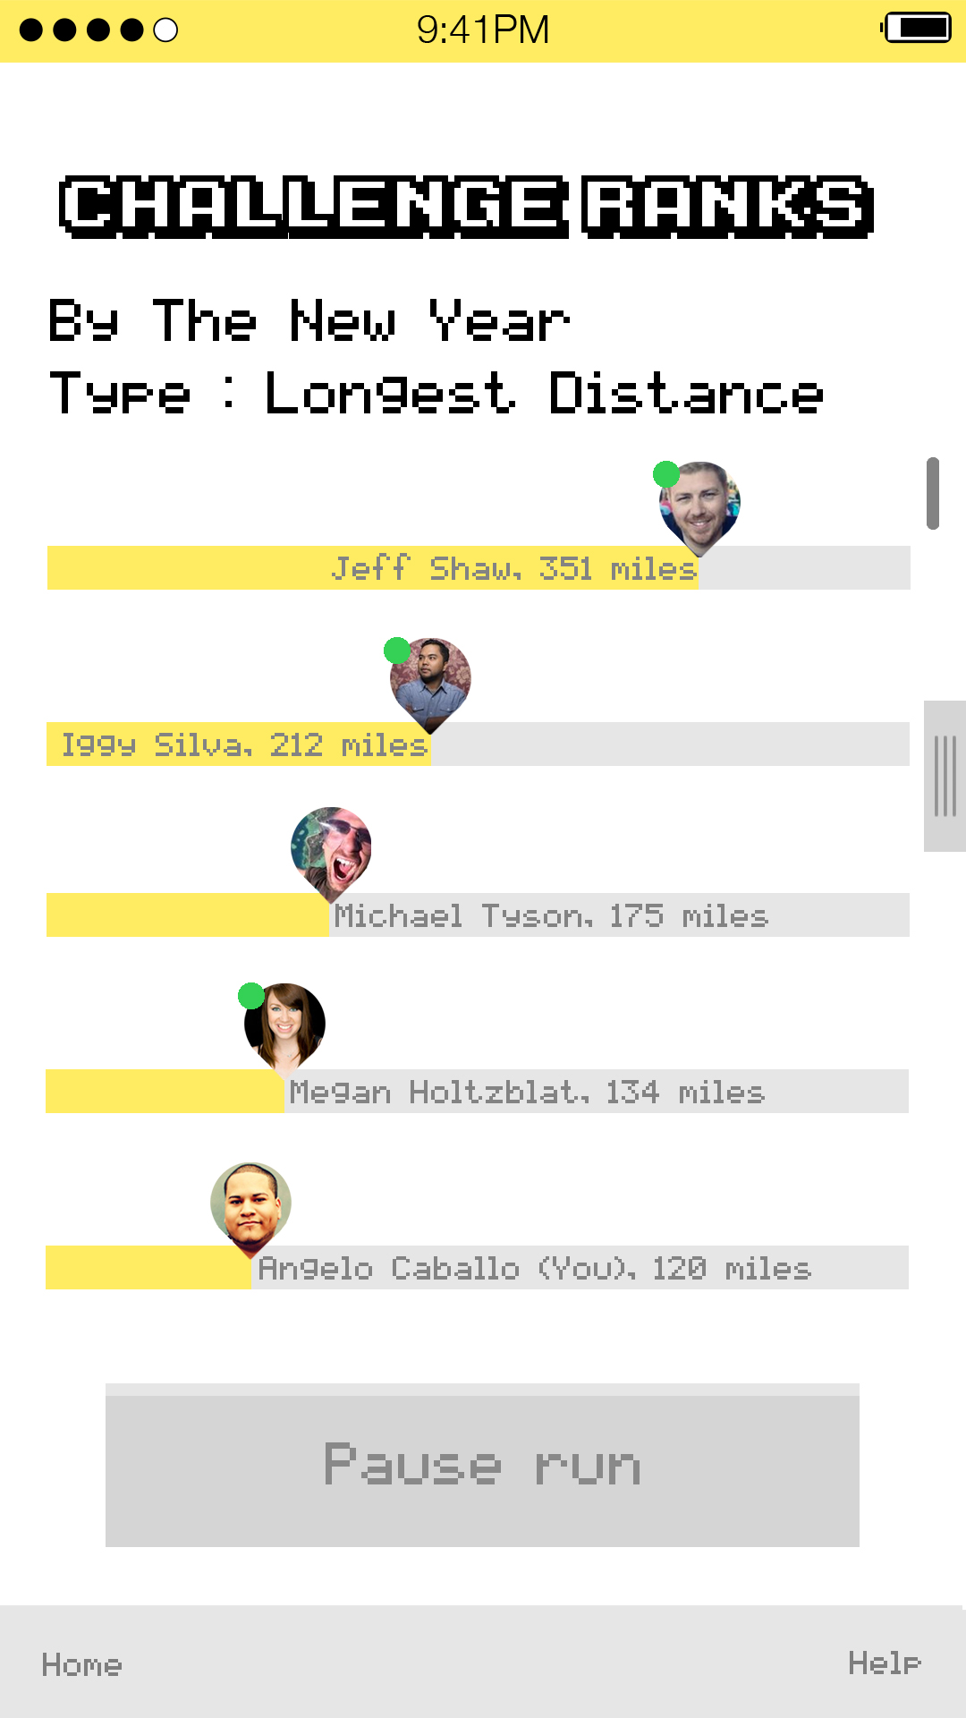
Medium Fidelity Prototyping - Mobile

Slide 6
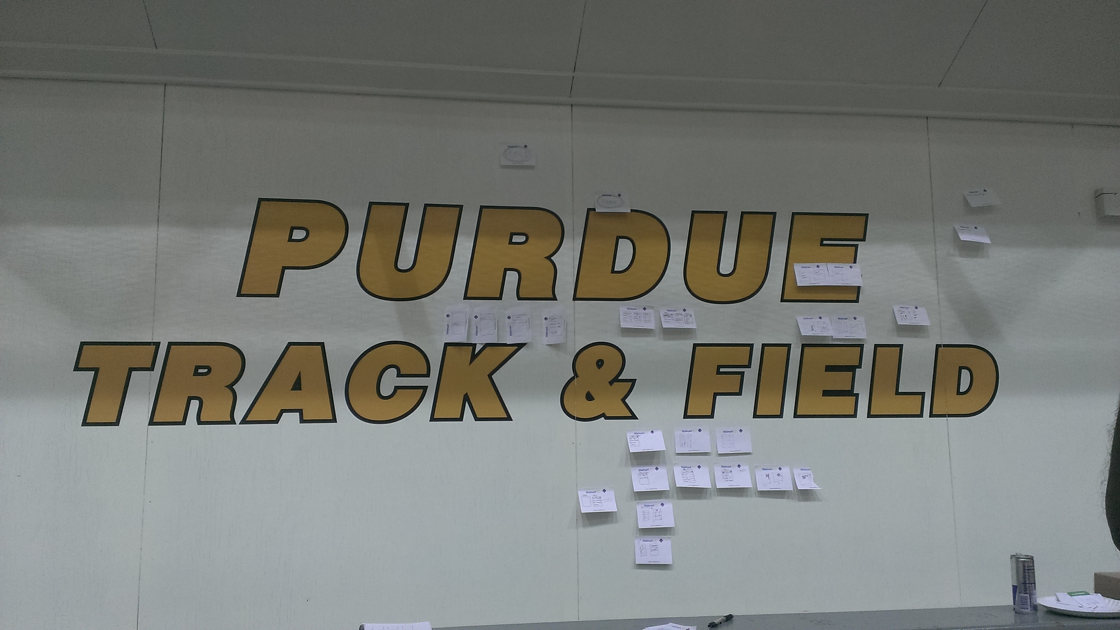
User Interface Flow

Slide 7
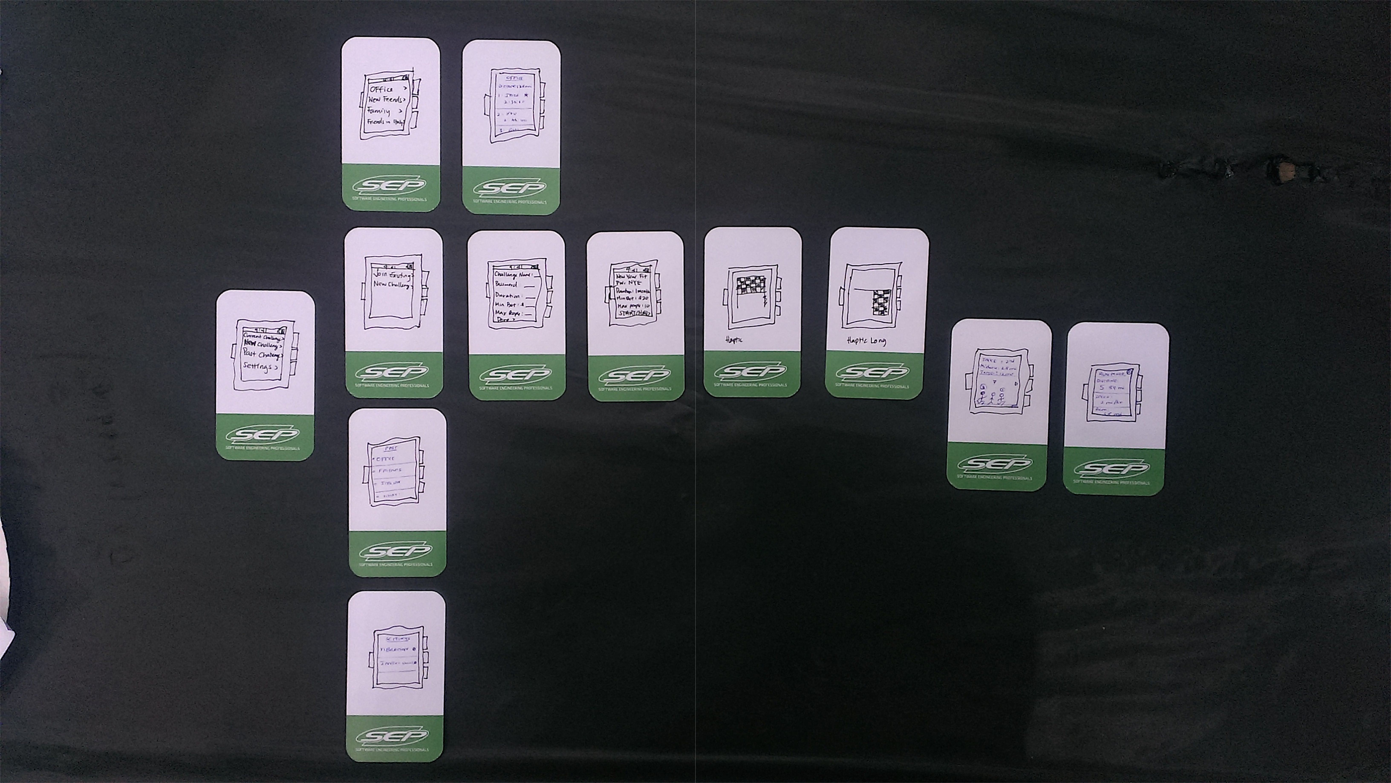
Paper Prototyping

Slide 8
Start
Concept
Process
Implementation
Future
The Team

Slide 9
Start
Concept
Process
Implementation
Future
The Team

Slide 10
Start
Concept
Process
Implementation
Future
The Team

Slide 11
Start
Concept
Process
Implementation
Future
The Team

